Slide 1
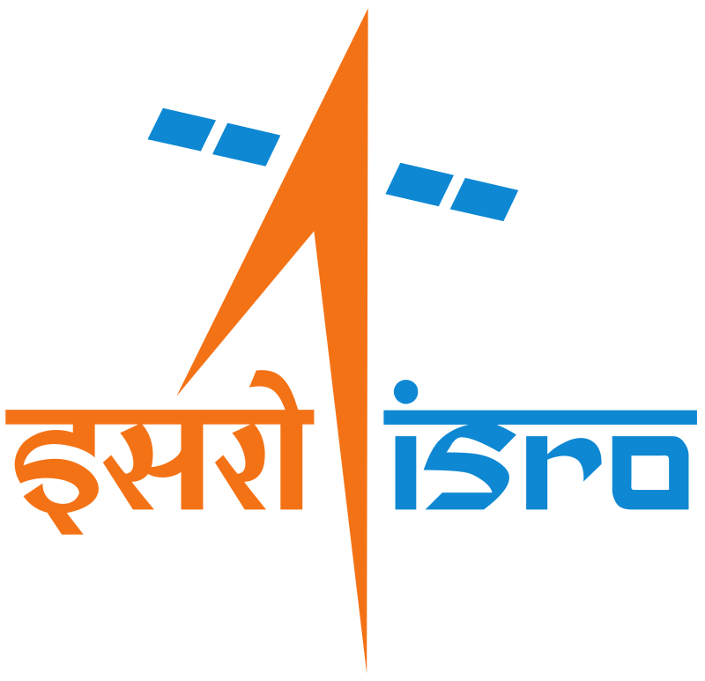
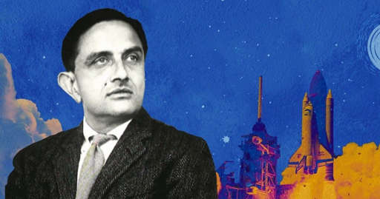
ISRO
Indian Space Research Organisation
Dr. Vikram Sarabhai
15 August 1969

Slide 2
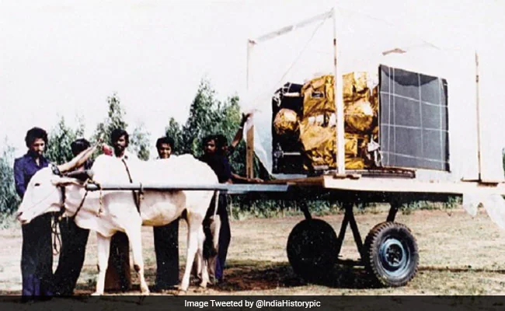
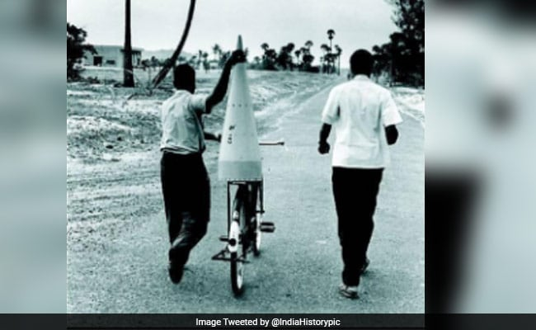

Slide 3
Short Intro
Established - 15 August 1969
Established by - Vikram sarabhai
Headquarters - Bangalore,India
Chairman - S somanath
Employees - 16,786
Annual budget - 13,700 crore
Mission-116 spacecraft,86 launch mission,
237 foreign satelite
First satellite – Aryabhata (19 April 1975)
Rockets - GSLV,PSLV,(SSLV,NSLV)

Slide 4
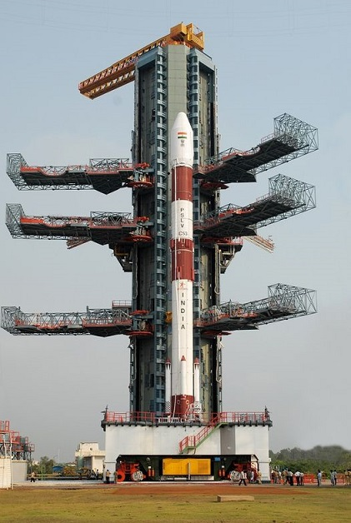
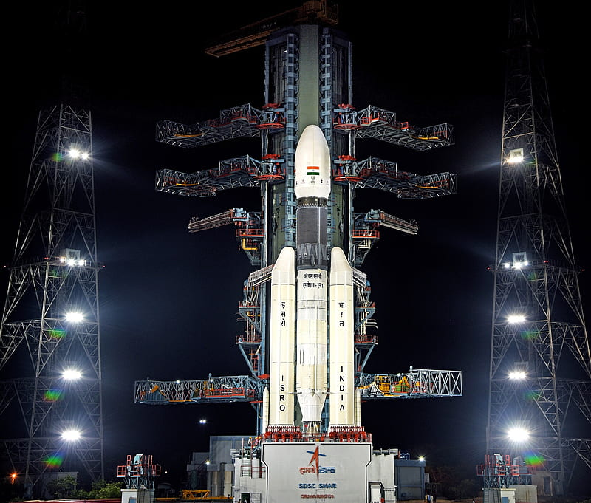

Slide 5
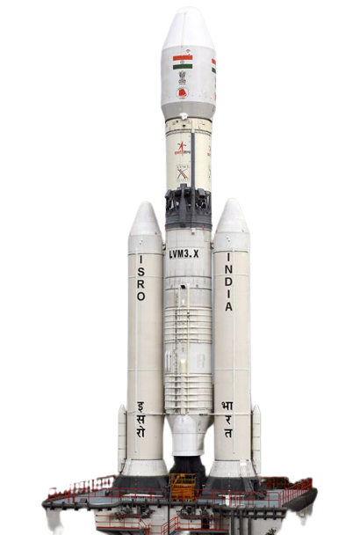
GSLV-MK3
PSLV
SSLV

Slide 6
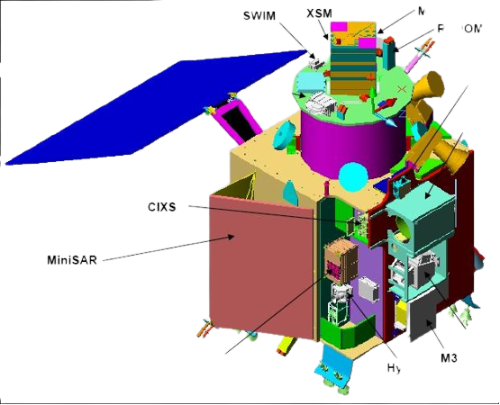
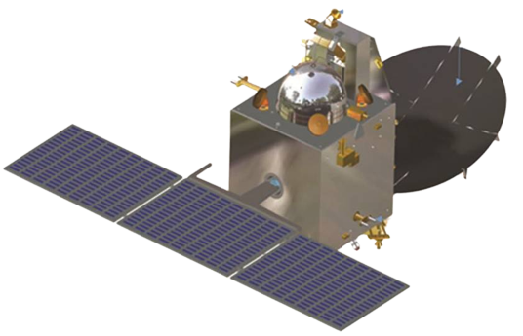
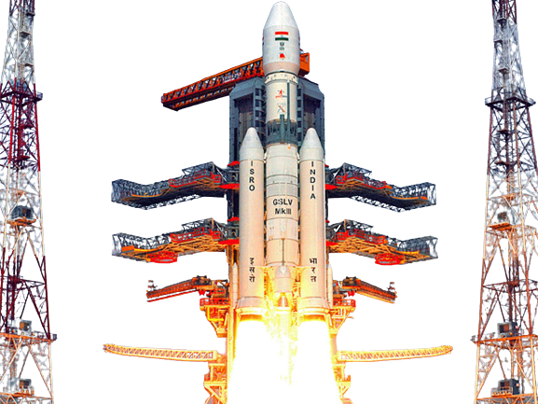
Some Achievement of ISRO
Chandrayaan 1 mission
22 Oct 2008
Mangalyaan mission
5 Nov 2013
104 satelite
16 Feb 2017

Slide 7
Some failed mission of ISRO
GISAT-1
Experimental flight of SLV- 3
GSLV- F02
PSLV-C39 41st flight
SROSS
First flite of SSLV
Chandrayaan-2
22 July 2019

Slide 8
Some future mission of ISRO Gaganyaan mission Sukryaan mission Aaditya L-1 Chandrayaan-3

